Slide 1

COMP1631 Advanced Spreadsheets – Winter 2024 – Section 06

Slide 2
COMP1631 Advanced Spreadsheets – Winter 2024 – Section 06
Lecture 9 Tuesday, March 12, 2024
Module 8
Performing What-If Analyses

Slide 3
COMP1631 Advanced Spreadsheets – Winter 2024 – Section 06
Download:
Module_8_Observe.xlsx
Module_8_Apply.xlsx
Open both excel files, we will be moving back-and-forth between the slides and these Excel files.

Slide 4
COMP1631 Advanced Spreadsheets – Winter 2024 – Section 06
Warm up:
Follow along the first few instructions in Module_8_Observe.xlsx.

Slide 5
Module 8 Objectives
Explore the principles of cost-volume-profit relationships
Create a one-variable data table
Create a two-variable data table
Create and apply different Excel scenarios with the Scenario Manager
Generate a scenario summary report

Slide 6
Module 8 Objectives
Generate a scenario PivotTable report
Explore the principles of a product mix
Run Solver to calculate optimal solutions
Create and apply constraints to a Solver model
Save and load a Solver model

Slide 7
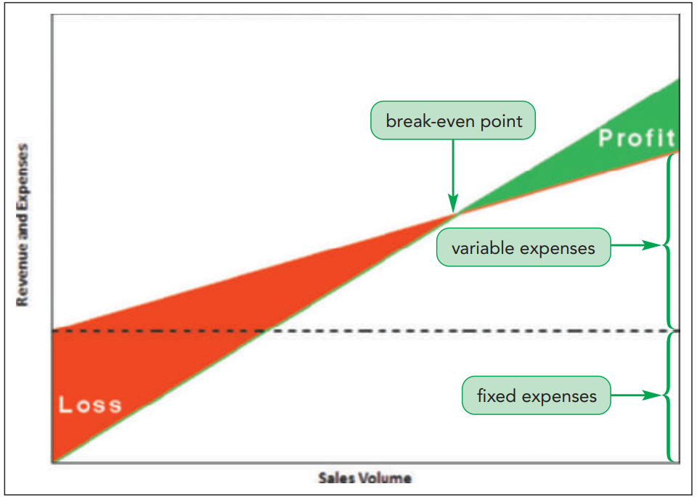
Understanding Cost–Volume Relationships
Cost-volume-profit (CVP) analysis
Studies the relationship between expenses, sales volume, and profitability
Helps predict the effect of cutting overhead or raising prices on a company’s net income

Slide 8

Understanding Cost–Volume Relationships
Exploring the Break-Even Point
The point where total revenue equals total expenses is called the break-even point
One way of finding the break-even point is to use Goal Seek, but a more efficient approach is to use a data table
Use Goal Seek to find the break-even point in Module_8_Observe.xlsx

Slide 9
Working with Data Tables
A data table is an Excel table that displays the results from several what-if analyses; the table consists of input cells and result cells
Input cells are the cells whose value would be changed in a what-if analysis
Result cells are cells whose values are impacted by the changing input values
You can use one-variable data tables and two-variable data tables

Slide 10
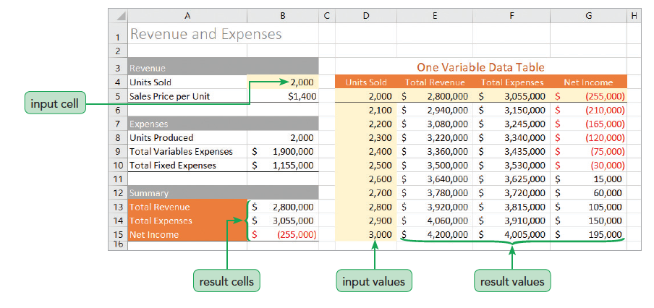
Working with Data Tables, Part 4

Slide 11
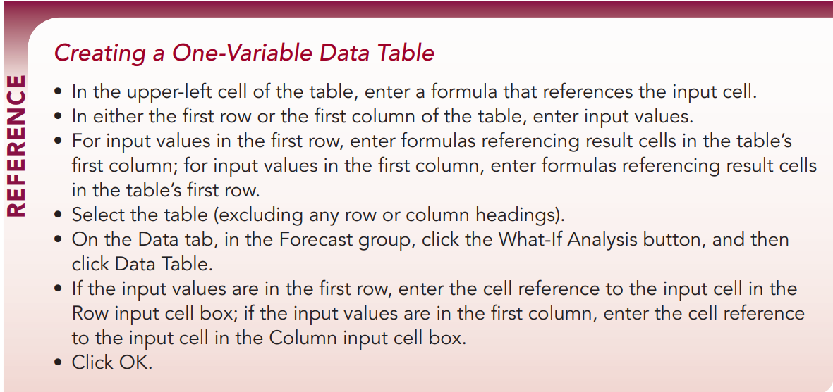
Creating One-Variable Data Tables
Follow along the instructions in Module_8_Observe.xlsx to create a one-variable data table.
Try it out yourself: Complete instruction 1. from Module_8_Apply.xlsx

Slide 12
Working with Data Tables
Charting a One-Variable Data Table
The chart gives a better picture of the relationship between sales volume, revenue, and expenses.
Modifying a Data Table
Data tables are dynamic; changes in the worksheet are automatically reflected in the data table values
Includes changes to cells that are not part of the data table but are involved in the values displayed in the result cells
Observe:
Create a CVP chart using instructions from Module_8_Observe.xlsx

Slide 13
Creating a Two-Variable Data Table
Lets you view the relationship between two input cells, but can display only a single result value
Analyzes a variety of combinations simultaneously
Formatting the Result Cell
You can hide a cell value using the custom format “text”, where text is the text you want to display in place of the cell value
Charting a Two-Variable Data Table
You can chart the values from a two-variable data table using lines to represent the different columns of the table

Slide 14
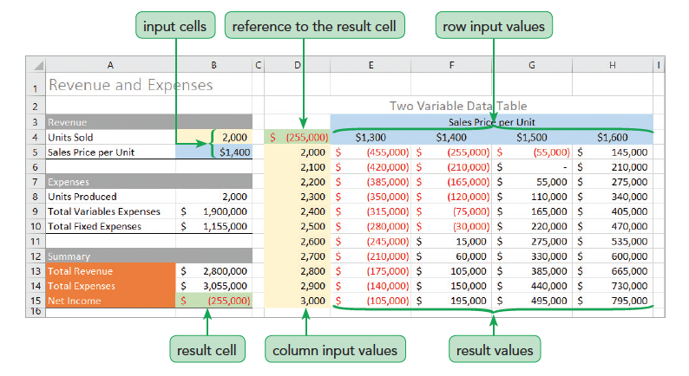
Creating a Two-Variable Data Table, Part 3

Slide 15
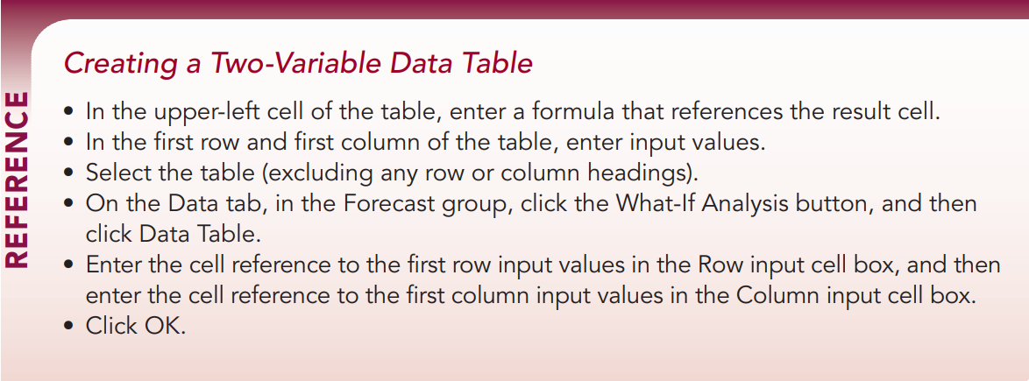
Creating a Two-Variable Data Table
Observe: Follow the instructions in Module_8_Observe.xlsx to create a 2-variable data table and a scatter chart.
Apply: Switch to Module_8_Apply.xlsx
Work through instructions 2., 3., 4., and 5. to create a two-variable data table and a scatter chart based on a data table.

Slide 16
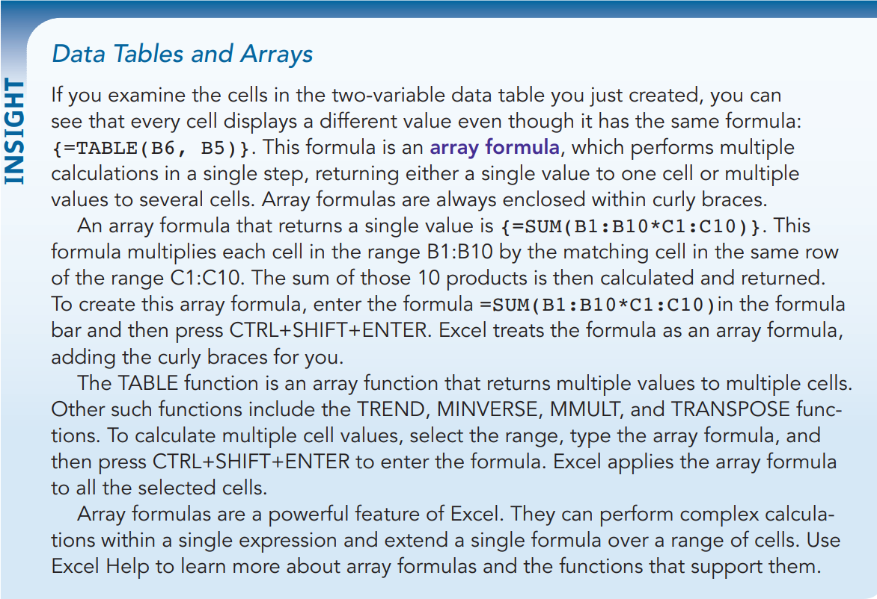
Working with Data Tables, Part 4

Slide 17
COMP1631 Advanced Spreadsheets – Winter 2024 – Section 06
Let’s go for a break!
Return in 15 minutes (or at time specified by your instructor).

Slide 18
Exploring Financial Scenarios with the Scenario Manager
Create scenarios to perform a what-if analysis with more than two input cells
A scenario is a defined set of values for different cells grouped under a common name
Create scenarios using the Scenario Manager
Lets you define input values within a named scenario and quickly switch from one to the other
Can be used to create summary reports

Slide 19
Exploring Financial Scenarios with the Scenario Manager
Before using the Scenario Manager
Define names for all input and result cells that you intend to use in the analysis
Defined names automatically appear in reports generated by the Scenario Manager
Using defined names makes it easier to work with scenarios and understand the scenario reports

Slide 20
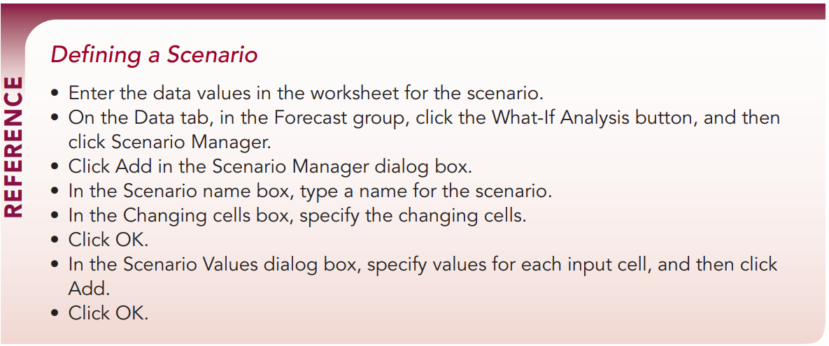
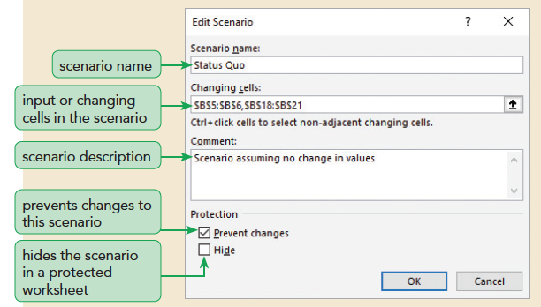
Observe creating a scenario and then try it yourself with instruction 6. in Module_8_Apply.xlsx

Slide 21
Exploring Financial Scenarios with the Scenario Manager
Viewing Scenarios
View the effect of each scenario by selecting it in the Scenario Manager dialog box
Switch from one scenario to another by clicking the Show button in the Scenario Manager dialog box
Excel automatically changes the values of the input cells to match the scenario
Editing a Scenario
Edit the assumptions to view other possible outcomes
Worksheet calculations are automatically updated to reflect the new scenario
Observe: follow the instructions on Module_8_Observe.xlsx for viewing scenarios

Slide 22
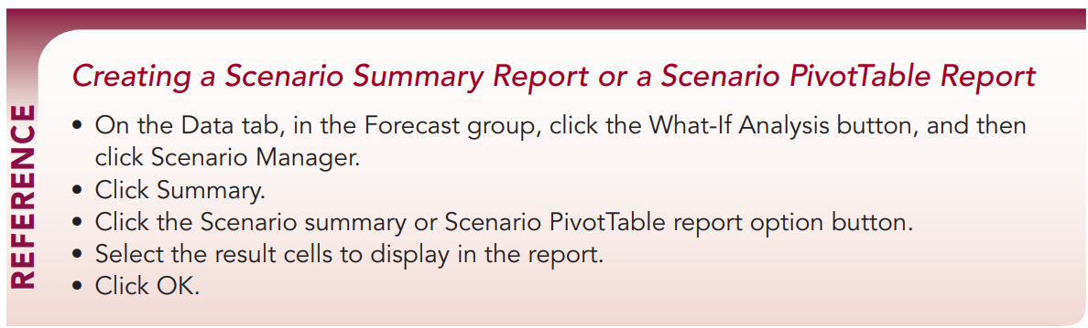
Creating a Scenario Summary Report
Create a report either as an Excel table or as an Excel PivotTable to compare the results from multiple scenarios on a single worksheet
To create a scenario summary report, you must identify which result cells you want to include in the report

Slide 23
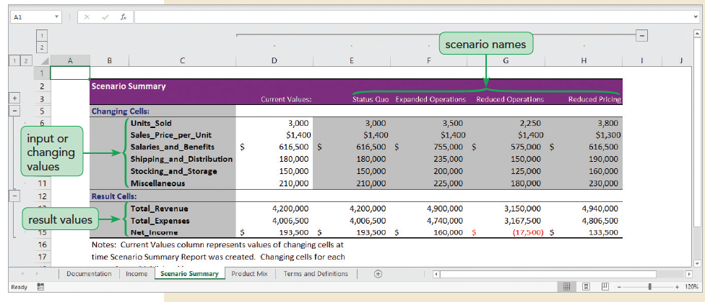
Creating a Scenario Summary Report, Part 2

Slide 24
Creating a Scenario Summary Report
A Scenario PivotTable report displays results from each scenario as a PivotTable field in a PivotTable
Scenario PivotTable reports are created through the Scenario Manager used to create a summary report
You can edit the scenario PivotTable to make it easier to read
Results for a scenario PivotTable can be displayed in a PivotChart
Apply: work through instructions 7., 8., and 9. in Module_8_Apply.xlsx

Slide 25
COMP1631 Advanced Spreadsheets – Winter 2024 – Section 06
Let’s go for a break!
Return in 15 minutes (or at time specified by your instructor).

Slide 26
Optimizing a Product Mix
The combination of products offered by a company is known as the company’s product mix
Products differ in their sales price, production costs, and attractiveness to consumers
A company might find that it is more profitable to devote more of its resources to selling one product over another
Goal is to maximize profits while meeting the demands of the market
The optimal product mix is the product mix that will result in the most profit for the company

Slide 27
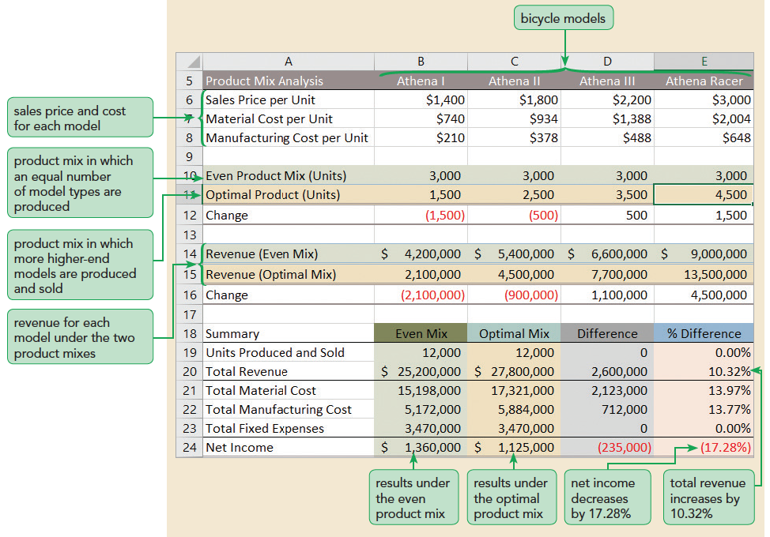
Optimizing a Product Mix, Part 2

Slide 28

Optimizing a Product Mix
Different product mixes result in lower or higher profit for the company
The best way to find the optimal product mix usually isn’t obvious; there are too many possible combinations
To find the one product mix that results in the maximum net profit for the company, you can use Solver

Slide 29
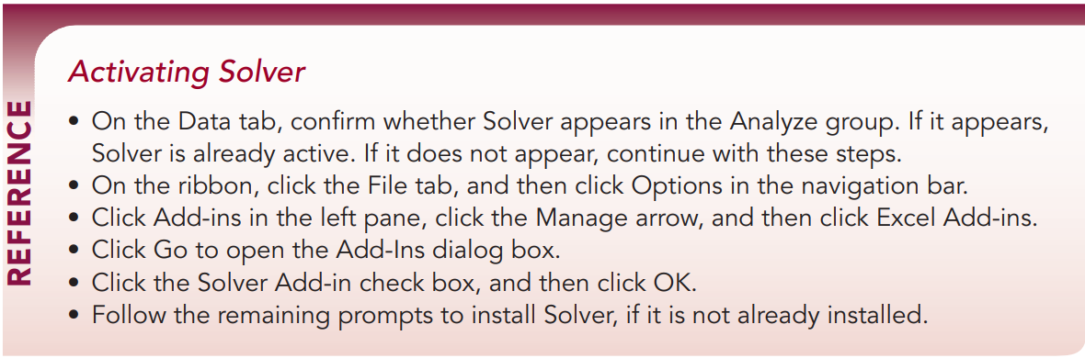

Finding an Optimal Solution Using Solver
Solver finds the numeric solution to a problem involving several input values
Solver can:
Be used to find the combination of input values that maximizes profits
Be used to find a set of input values that minimizes costs
Act like Goal Seek and find the input values required to match a given result

Slide 30
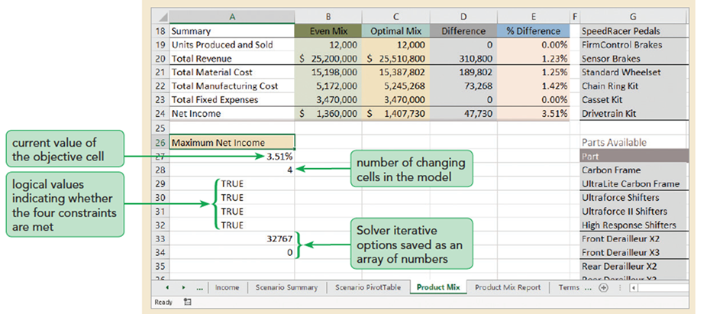
Finding an Optimal Solution Using Solver
Setting the Objective Cell and Variable Cells
Every Solver model needs an objective cell and one or more variable cells
An objective cell is a result cell that is maximized, minimized, or set to a specific value
A variable cell is an input cell that changes so that the objective cell can meet its defined goal

Slide 31
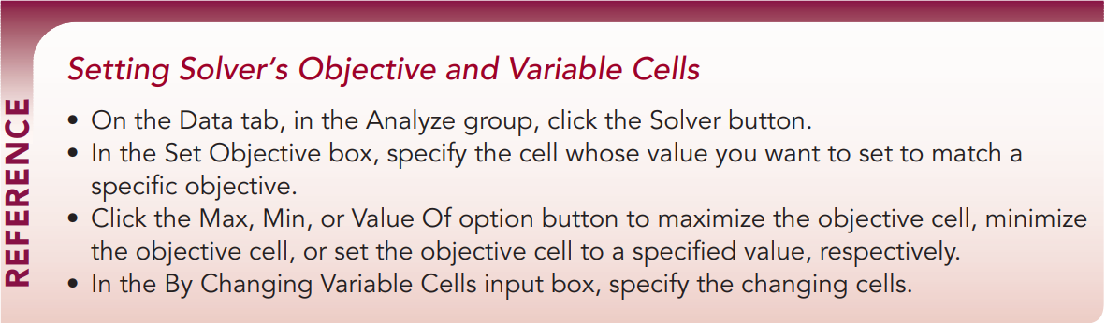
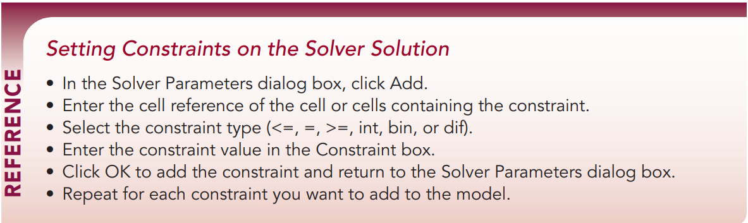
Finding an Optimal Solution Using Solver
Adding Constraints to Solver
Almost every Solver model needs one or more constraints
A constraint is a limit that is placed on the solution
Solver supports six types of constraints
Observe and Apply: Go through the remaining instructions in the two Excel files that are open.

Slide 32
Exploring the Iterative Process
Solver arrives at optimal solutions through an iterative process, in which Solver starts with an initial solution and uses that as a basis to calculate a new solution.
Solver refers to the overall highpoint as the global optimum while a nearby high point is the local optimum.
Solver also supports the following iterative methods:
Simplex LP method
GRG Nonlinear method
Evolutionary method

Slide 33
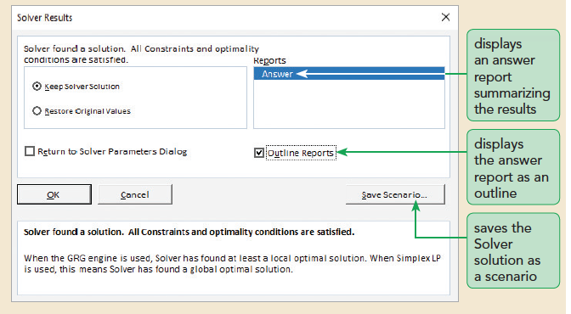
Creating a Solver Answer Report
Solver can create three different reports
Answer report summarizes the results of a successful solution by displaying information about the objective cell, changing cells, and constraints
Sensitivity report and limits report are often used in science and engineering to investigate the mathematical aspects of the Solver solution; these reports allow you to quantify the reliability of the solution

Slide 34
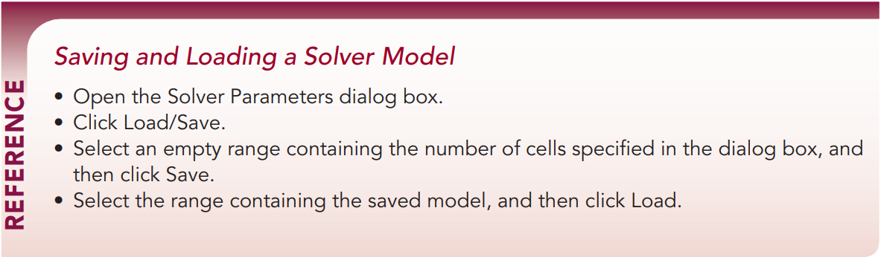
Saving and Loading Solver Models

Slide 35

End of Lecture
Do not forget to do Module 8 Textbook Project and Module 8 SAM exam before 11:59pm on Monday, March 18, 2024.
Prepare yourself for Module 8 SAM Project in class on March 18, 2024.
Have fun and see you next week!

